Slide 1
Business Intelligence at Contoso
Initiative Validation Kickoff
21 Nov 201x

Slide 2
BI Initiative Validation at Contoso
Initiative Validation Kickoff
21 Nov 201x

Slide 3
Value Realization Framework
Questions & Clarifications ?

Slide 5
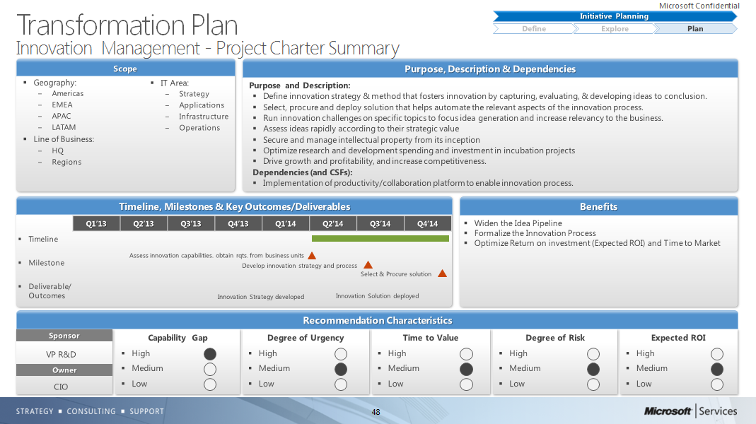
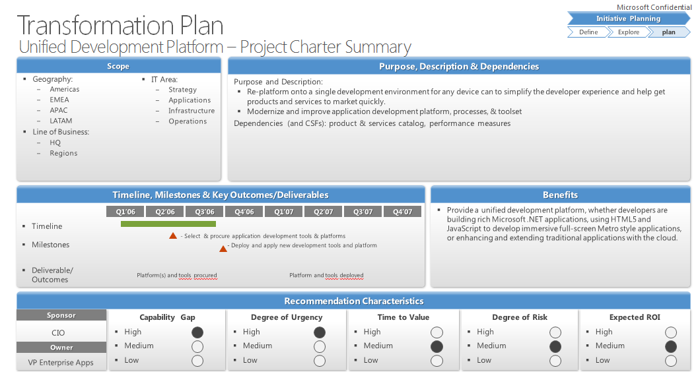
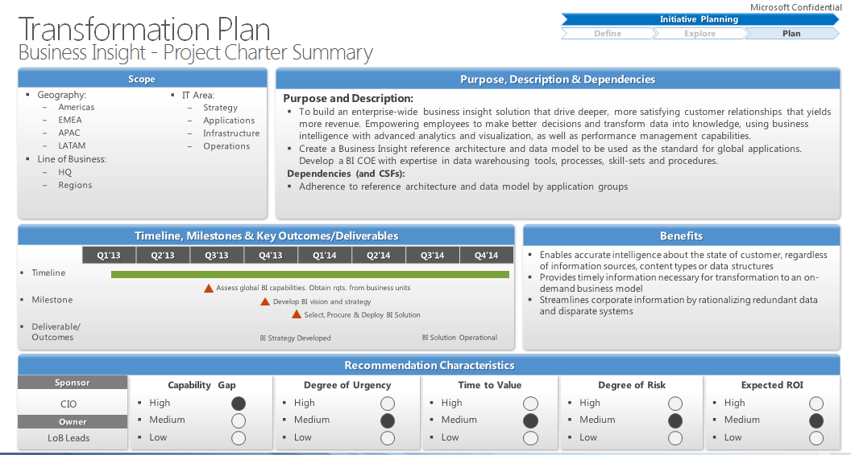
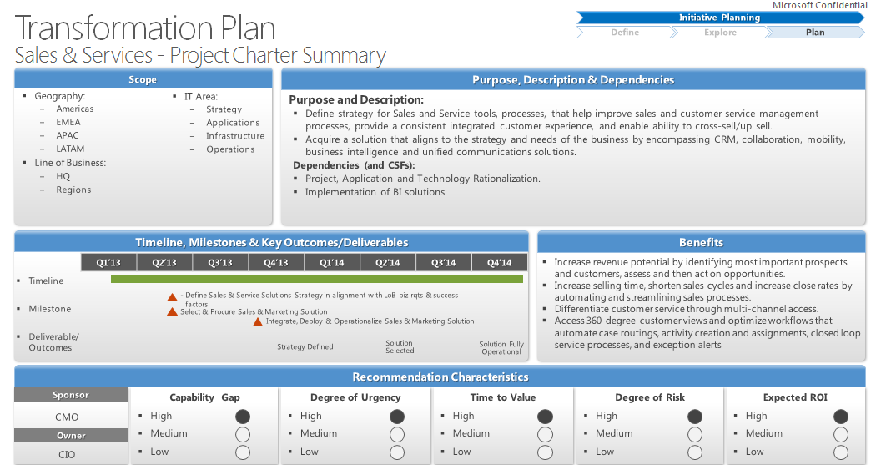
#1
#2
#3
#4

Slide 6

Digital Marketing
(e-commerce, search, advertisement)
Cloud Services
(SaaS, PaaS, IaaS)
High
(> 50%)
Unified
Development
Platform
Business
Insight
Sales & Service
(CRM)
Medium
(20-50%)
Return on Investment
Innovation Mgmt.
Low
(5-20%)
Time to Value
3 - 6 Months
6-12 months
12-18+ months

